Slide 1
DERIVATIONS OF TRIGONOMETRIC IDENTITIES
PYTHAGOREAN IDENTITES
EVEN & ODD IDENTITIES
DOUBLE ANGLE IDENTITIES

Slide 2
NOTE
The following slides introduce you to the derivations for all of the trigonometry identities you have to have memorized. You will not be learning them all at once, so go through the ones that you need to learn and then come back later.

Slide 3
PYTHAGOREAN IDENTITIES

Slide 4
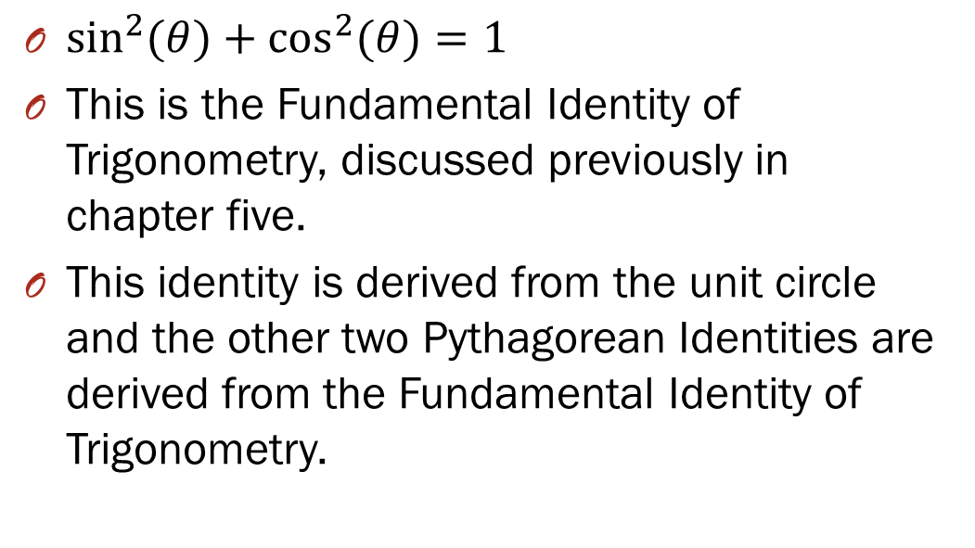
PYTHAGOREAN IDENTITIES
$\sin^{2}{(θ)}+\cos^{2}{(θ)}=1$
This is the Fundamental Identity of Trigonometry, discussed previously in chapter five.
This identity is derived from the unit circle and the other two Pythagorean Identities are derived from the Fundamental Identity of Trigonometry.

Slide 5

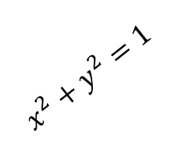




PYTHAGOREAN IDENTITIES $$\sin^{2}{(θ)}+\cos^{2}{(θ)}=1$$
We begin with the unit circle.
We draw a standard angle in the first quadrant. This gives a point on the circle at $\left(x,y\right).$
$$\left(x,y\right)$$
$$x^{2}+y^{2}=1$$
y
$$θ$$
$$x$$
We can use Pythagorean’s Theorem to write an equation showing the relationship.

Slide 6


PYTHAGOREAN IDENTITIES $$\sin^{2}{(θ)}+\cos^{2}{(θ)}=1$$
We now remember that the cosine function is the $x$-value and the sine function is the $y$-value.
$$\left(x,y\right)$$
$$x^{2}+y^{2}=1$$
y
$$θ$$
$$x$$
By substitution into the Pythagorean Theorem we get:
$$\sin^{2}{(θ)}+\cos^{2}{(θ)}=1$$ or
$${\cos^{2}{(θ)}+sin}^{2}{(θ)}=1$$

Slide 7
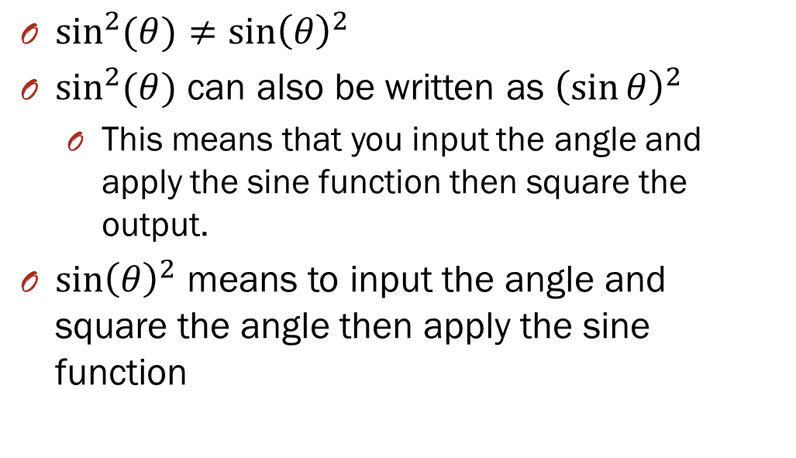
NOTE
$\sin^{2}{(θ)}≠{\sin\left(θ\right)}^{2}$
$\sin^{2}{(θ)}$ can also be written as ${\left(\sin{θ}\right)}^{2}$
This means that you input the angle and apply the sine function then square the output.
${\sin\left(θ\right)}^{2}$ means to input the angle and square the angle then apply the sine function

Slide 8
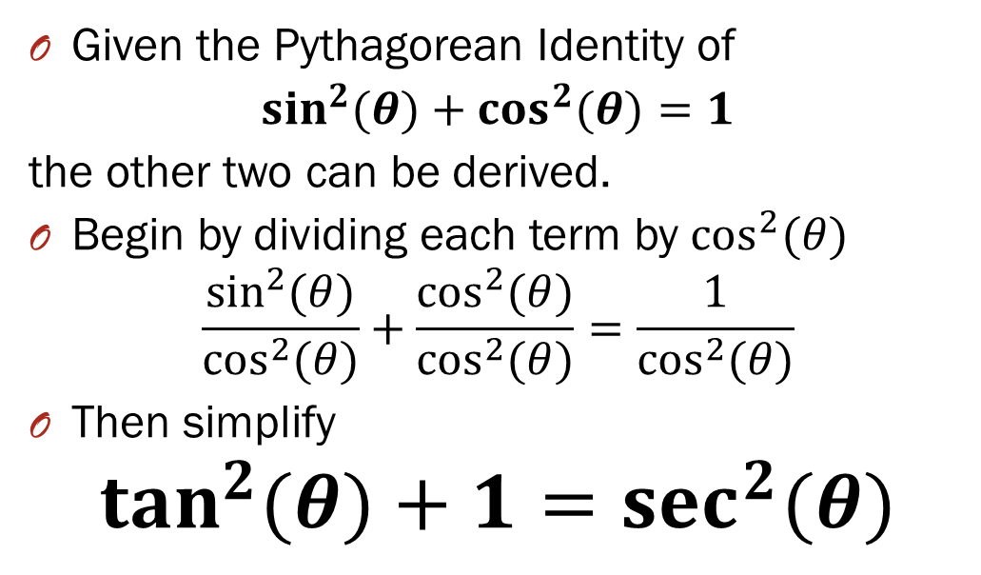
PYTHAGOREAN IDENTITIES
Given the Pythagorean Identity of
$\sin^{2}{(θ)}+\cos^{2}{(θ)}=1$
the other two can be derived.
Begin by dividing each term by $\cos^{2}{(θ)}$
$$\frac{\sin^{2}{(θ)}}{\cos^{2}{(θ)}}+\frac{\cos^{2}{(θ)}}{\cos^{2}{(θ)}}=\frac{1}{\cos^{2}{(θ)}}$$
Then simplify
$$\tan^{2}{(θ)}+1=\sec^{2}{(θ)}$$

Slide 9
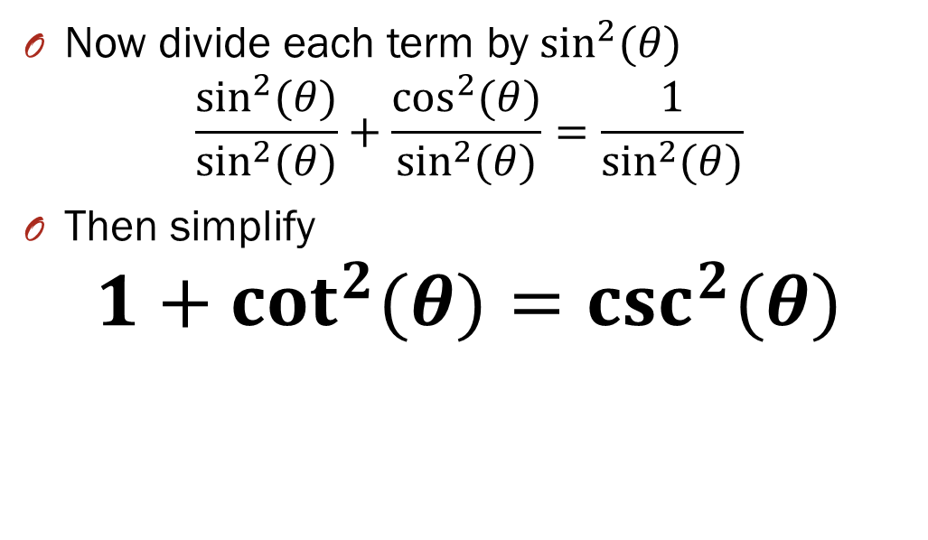
PYTHAGOREAN IDENTITIES
Now divide each term by $\sin^{2}{(θ)}$
$$\frac{\sin^{2}{(θ)}}{\sin^{2}{(θ)}}+\frac{\cos^{2}{(θ)}}{\sin^{2}{(θ)}}=\frac{1}{\sin^{2}{(θ)}}$$
Then simplify
$$1+\cot^{2}{(θ)}=\csc^{2}{(θ)}$$

Slide 10
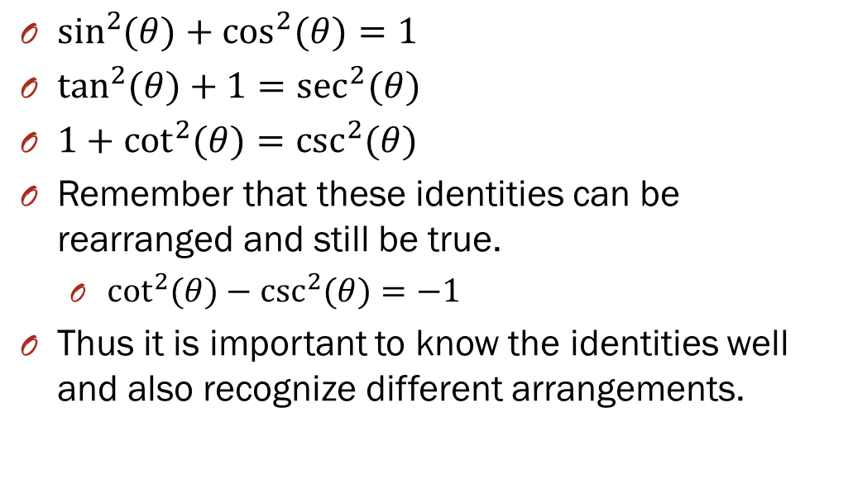
3 Pythagorean Identities
$\sin^{2}{(θ)}+\cos^{2}{(θ)}=1$
$\tan^{2}{(θ)}+1=\sec^{2}{(θ)}$
$1+\cot^{2}{(θ)}=\csc^{2}{(θ)}$
Remember that these identities can be rearranged and still be true.
$\cot^{2}{(θ)}−\csc^{2}{(θ})=−1$
Thus it is important to know the identities well and also recognize different arrangements.

Slide 11
EVEN AND ODD IDENTITIES

Slide 12
Even and Odd Identities
From your trig identity sheet notice that you only need to have two memorized.
But recognize that the other 4 identities follow a similar pattern.

Slide 13
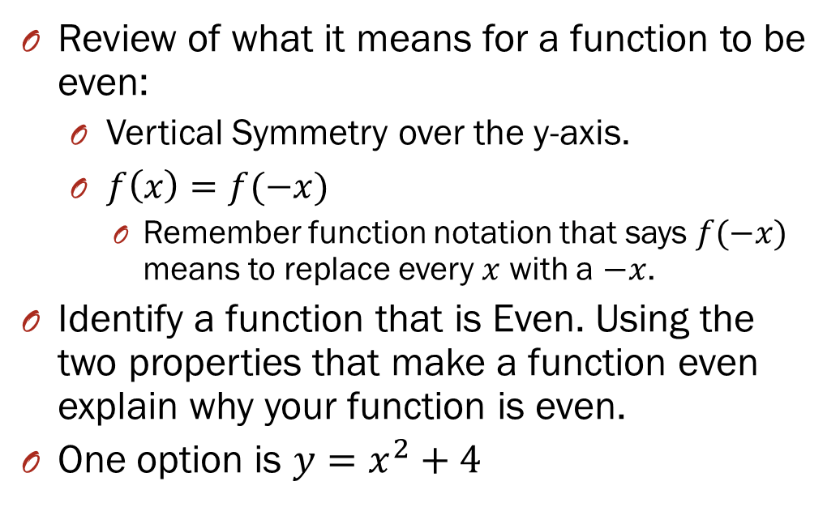
Even Functions
Review of what it means for a function to be even:
Vertical Symmetry over the y-axis.
$f\left(x\right)=f(−x)$
Remember function notation that says $f(−x)$ means to replace every $x$ with a $−x$.
Identify a function that is Even. Using the two properties that make a function even explain why your function is even.
One option is $y=x^{2}+4$

Slide 14
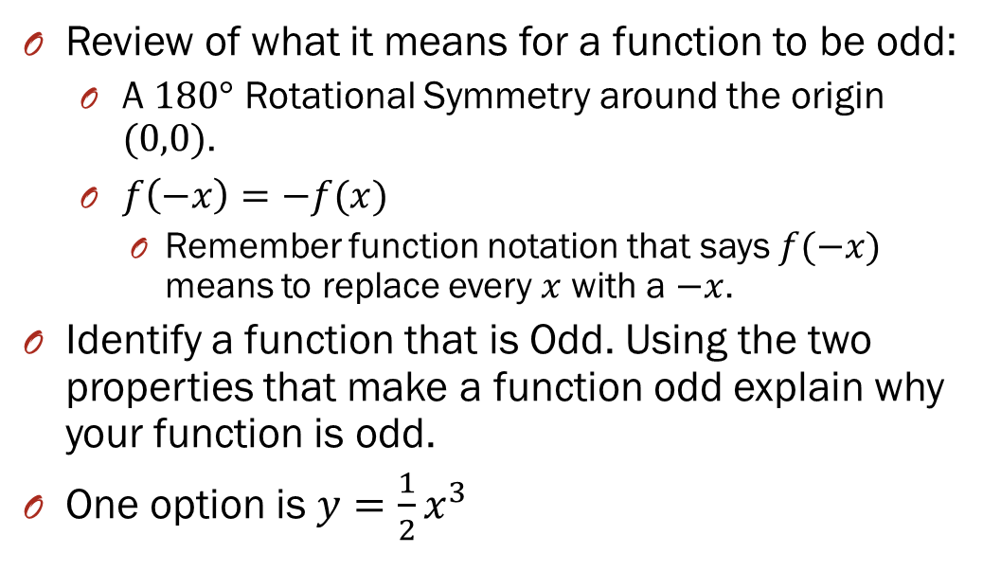
Odd Functions
Review of what it means for a function to be odd:
A $180°$ Rotational Symmetry around the origin $(0,0)$.
$f\left(−x\right)=−f(x)$
Remember function notation that says $f(−x)$ means to replace every $x$ with a $−x$.
Identify a function that is Odd. Using the two properties that make a function odd explain why your function is odd.
One option is $y=\frac{1}{2}x^{3}$

Slide 15
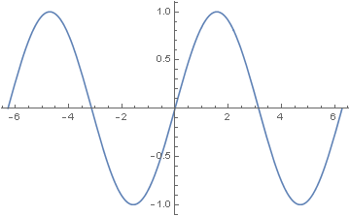
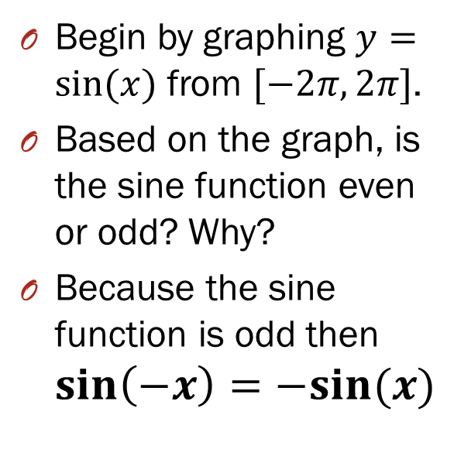
The Sine Function Even or Odd??
Begin by graphing $y=sin⁡(x)$ from $[−2π,2π]$.
Based on the graph, is the sine function even or odd? Why?
Because the sine function is odd then $\sin\left(−x\right)=−sin⁡(x)$
ODD

Slide 16
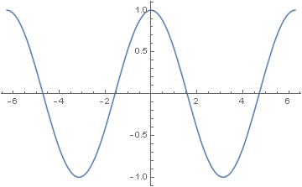
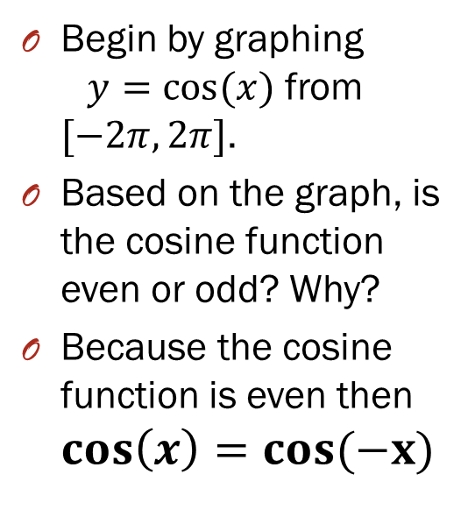
The Cosine Function Even or Odd??
Begin by graphing $y=cos⁡(x)$ from $[−2π,2π]$.
Based on the graph, is the cosine function even or odd? Why?
Because the cosine function is even then $\cos\left(x\right)=cos(−x)$
EVEN

Slide 17


Which functions are….
Even
$$\cos\left(x\right)$$
$$sec⁡(x)$$
Odd
$$\sin\left(x\right)$$
$$\csc\left(x\right)$$
$$\tan\left(x\right)$$
$$cot⁡(x)$$

Slide 18
DOUBLE ANGLE IDENTITIES

Slide 19
Double Angle Identities
From your trig identity sheet notice that you need to memorize the double angle identity for the sine function and for the cosine function (all three versions).

Slide 20
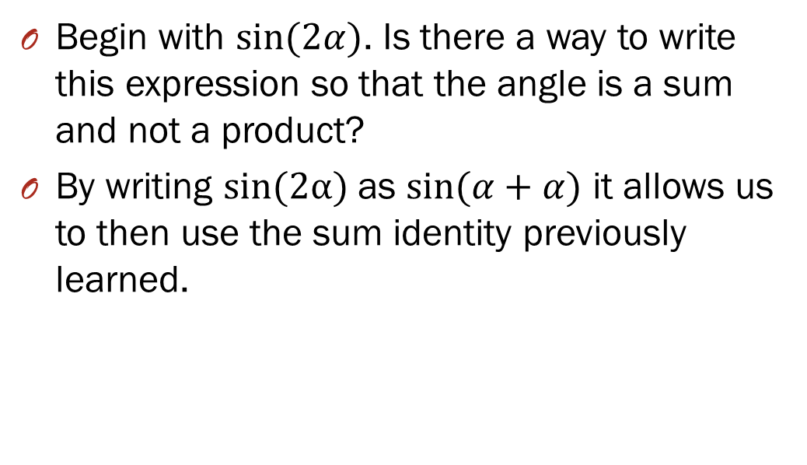
Double Angle Identity for Sine
Begin with $sin⁡(2α)$. Is there a way to write this expression so that the angle is a sum and not a product?
By writing $sin(2α)$ as $sin⁡(α+α)$ it allows us to then use the sum identity previously learned.

Slide 21
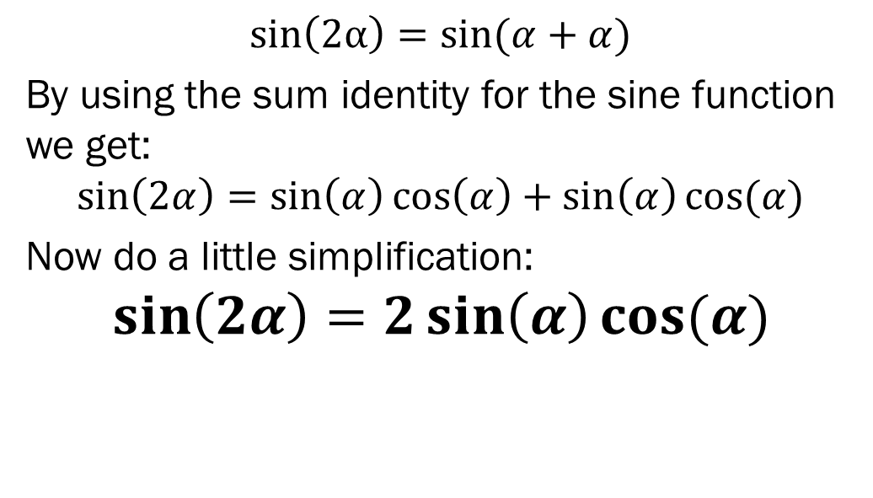
Double Angle Identity for Sine
$sin\left(2α\right)=sin⁡(α+α)$
By using the sum identity for the sine function we get:
$$\sin\left(2α\right)=\sin\left(α\right)\cos\left(α\right)+\sin\left(α\right)cos⁡(α)$$
Now do a little simplification:
$$\sin\left(2α\right)=2\sin\left(α\right)cos⁡(α)$$

Slide 22

Double Angle Identity for Cosine
We can use a similar reasoning to find the double angle identity for the cosine function.
Begin be rewriting $cos⁡(2α)$ so that the angle is a sum.

Slide 23
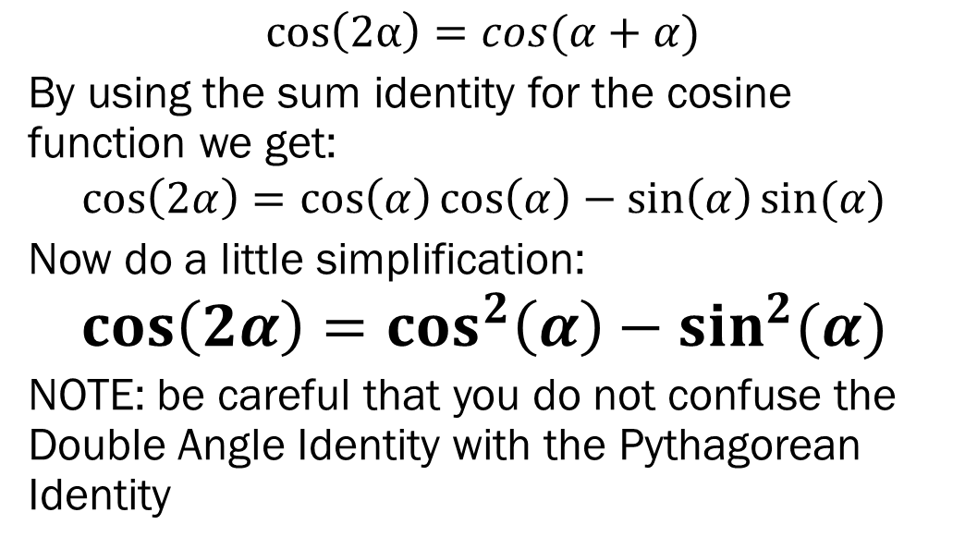
Double Angle Identity for Cosine
$cos\left(2α\right)=cos⁡(α+α)$
By using the sum identity for the cosine function we get:
$$\cos\left(2α\right)=\cos\left(α\right)\cos\left(α\right)−\sin\left(α\right)sin⁡(α)$$
Now do a little simplification:
$$\cos\left(2α\right)=cos^{2}\left(α\right)−sin^{2}(α)$$
NOTE: be careful that you do not confuse the Double Angle Identity with the Pythagorean Identity

Slide 24
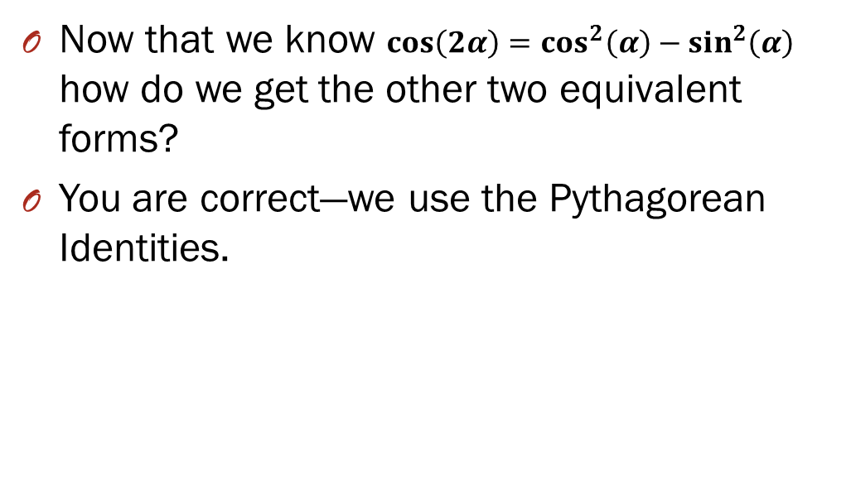
Double Angle Identity for Cosine
Now that we know $\cos\left(2α\right)=cos^{2}\left(α\right)−sin^{2}\left(α\right)$ how do we get the other two equivalent forms?
You are correct—we use the Pythagorean Identities.

Slide 25
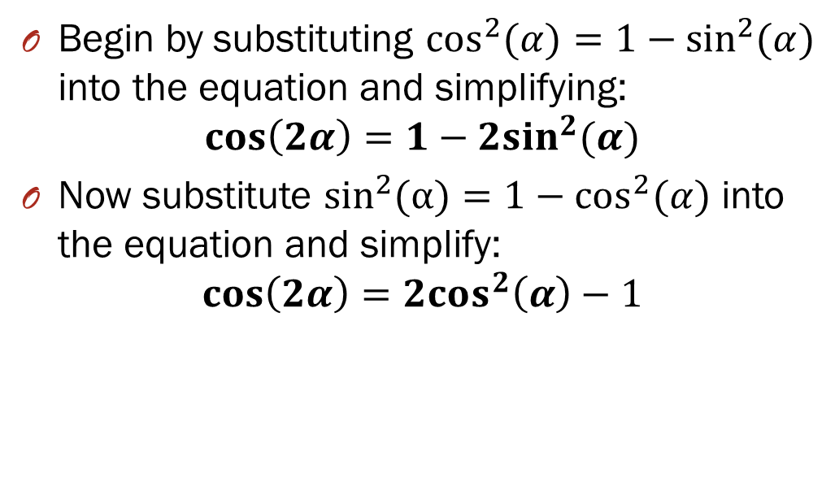
Double Angle Identities for Cosine
Begin by substituting $\cos^{2}{(α)}=1−\sin^{2}{(α)}$ into the equation and simplifying:
$$\cos\left(2α\right)=1−2sin^{2}(α)$$
Now substitute $\sin^{2}(α)=1−\cos^{2}{(α)}$ into the equation and simplify:
$$\cos\left(2α\right)=2cos^{2}\left(α\right)−1$$

Slide 26
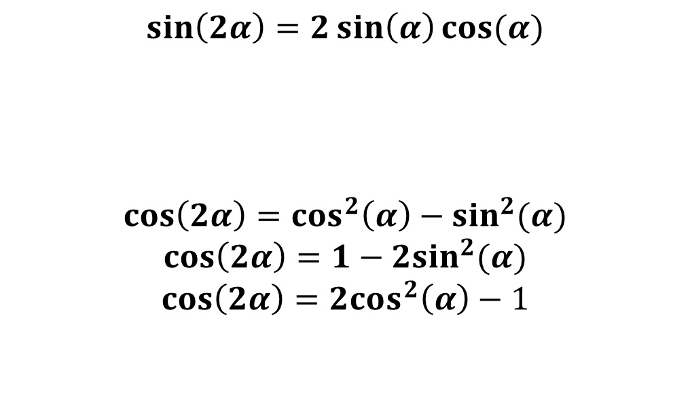
Double Angle Identities
$$\sin\left(2α\right)=2\sin\left(α\right)cos⁡(α)$$
$$\cos\left(2α\right)=cos^{2}\left(α\right)−sin^{2}(α)$$
$$\cos\left(2α\right)=1−2sin^{2}(α)$$
$$\cos\left(2α\right)=2cos^{2}\left(α\right)−1$$

